Slide 1
Relating Two Property Testing Models for Bounded Degree Directed Graphs
Pan Peng (University of Vienna, Austria)
Joint work with Artur Czumaj (University of Warwick, UK) Christian Sohler (TU Dortmund, Germany)

Slide 2
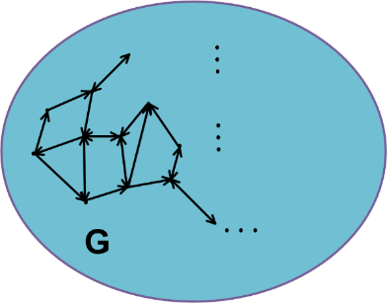
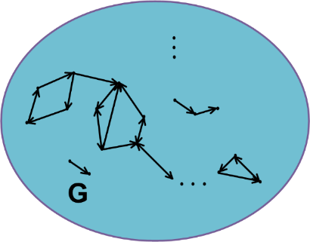
Introduction
Graph property testing:
-- To distinguish if a graph has a property or is “far from” having the property
strongly connected far from being strongly connected
Extensive study for undirected graphs
Lack of understanding of directed graphs
We provide a systematic way of studying property testing for directed graphs

Slide 3
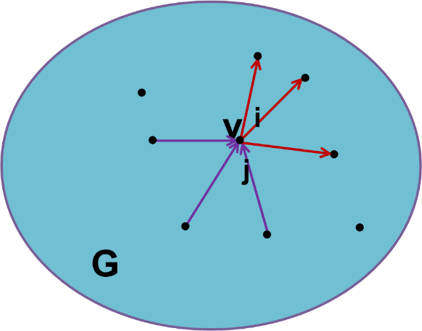
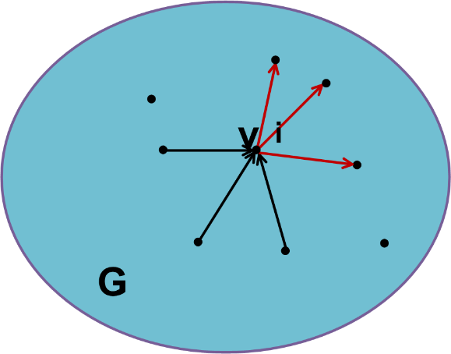
Two Models
d-bounded digraph $G$: a directed graph with max in-degree and max out-degree $≤d$
bidirectional model:
The algorithm can query both incoming and outgoing edges (or neighbors)
unidirectional model:
The algorithm can only query outgoing edges (or neighbors)
Goal: to distinguish if $G$ has a property $P$ or is 𝜀-far from having P by making as few queries as possible with probability $2/3$
$G$ is $ε$-far from having property P, if one has to insert/delete $>εdn$ edges to make it satisfy P
both $d, ε$ are assumed to be constant

Slide 4
Previous Work
Some ad hoc results on property testing for $d$-bounded digraphs:
-- bidirectional; constant-query testable properties: strong connectivity, star-freeness, Eulerianity, $k$-edge connectivity, $k$-vertex connectivity, …
-- unidirectional; NOT constant-query testable properties: strong connectivity, star-freeness, acyclicity (even in directional)
-- unidirectional; sublinear-query (i.e., $o\left(n\right)$-query) testable properties: strong connectivity, $3$-star-freeness

Slide 5
Our Result
Informally, a generic transformation:
➔
Theorem: Any d-bounded digraph property that can be tested with query
complexity $O_{ε,d}(1)$in the bidirectional model can be tested with
$n^{1−Ω_{ε,d}(1)}$queries in the unidirectional model.
constant-query testable; bidirectional
sublinear-query testable; unidirectional
Remarks:
$∃$property: bidirectional $O_{ε,d}(1)$, while unidirectional $Ω(n^{2/3})$ queries
“$d$-bounded” assumption is necessary: if unbounded, ∃ property: bidirectional $O_{ε,d}(1)$, while unidirectional $Ω(n^{1−o_{n}(1)})$ queries
Applications from Theorem: many new sublinear testers in the unidirectional model:
-- Eulerianity, $k$-edge connectivity, $k$-vertex connectivity, hyperfiniteness

Slide 6
High-Level Idea
In bidirectional model:
property $P$ constant-query testable
$⇒$ To test $P$, it suffices to approximate the “distribution of constant-size neighborhood”
In unidirectional model:
Use a sampling-based algorithm and a partial order of some constant-size graphs to iteratively approximate the above distribution

Slide 7
Open Questions
other relations between these two models?
what digraph properties can be tested with constant (or $\log^{C}n$, or $n^{α}$) query complexity in bidirectional (or unidirectional) model?
Reference:
[CPS16] Artur Czumaj, Pan Peng, and Christian Sohler. Relating two property testing models for bounded degree directed graphs. In Proceedings of the 48th Annual ACM SIGACT Symposium on Theory of Computing, STOC 2016

